Slide 1

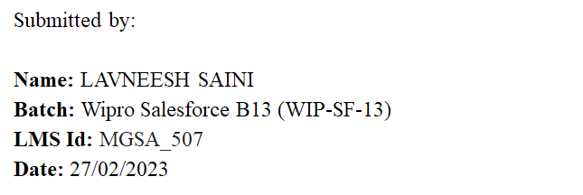
Capstone Presentation

Slide 2
Contents:
Travel Approval App (Module 1 & 2)
Code Playground App (Module 3)

Slide 3
Travel App
Objectives
Building a Lightning app, adding tabs, and customizing page layouts.
Creating custom objects and fields for the app.
Defining relationships between objects.
Importing data and testing the app.

Slide 4
Introduction
This project is about a Travel Approval App.
We need to build an app for an organisation by which employees can place the travel approval requests under their manager.
In which the manager has the privilege to approve or reject the request and the administrator can see the report of total requests by “Month” or by “Department” using a Dashboard.

Slide 5
Requirements for the App:
Each employee must submit an electronic request in the system for future travel.
Each request includes a list of estimated expenses for airfare, hotel, rental car, and so on.
Each request must be approved by the employee’s manager, and all out-of-state travel must be approved by a travel coordinator.
Managers need reports and dashboards to track key travel request trends and KPIs.
In addition, employees and managers must be able to access their travel requests, approvals, and dashboards via mobile device.

Slide 6
Steps Followed:
Creating Lightning Travel App Via App Manager
Creating Custom Objects Department, Travel Approval & Expense Items
Creating Custom Fields for the Custom Objects
Department Code, Location, Department Type for department objects
Purpose of trip, Trip Start/End Date, Destination State, etc for Travel Approval
Amount, Expense Type for Expense Item
Creating custom Tabs
Defining Relationships between objects.
Master Detail in Expense Item Related to Travel Approval
Lookup Related to Department Object

Slide 7
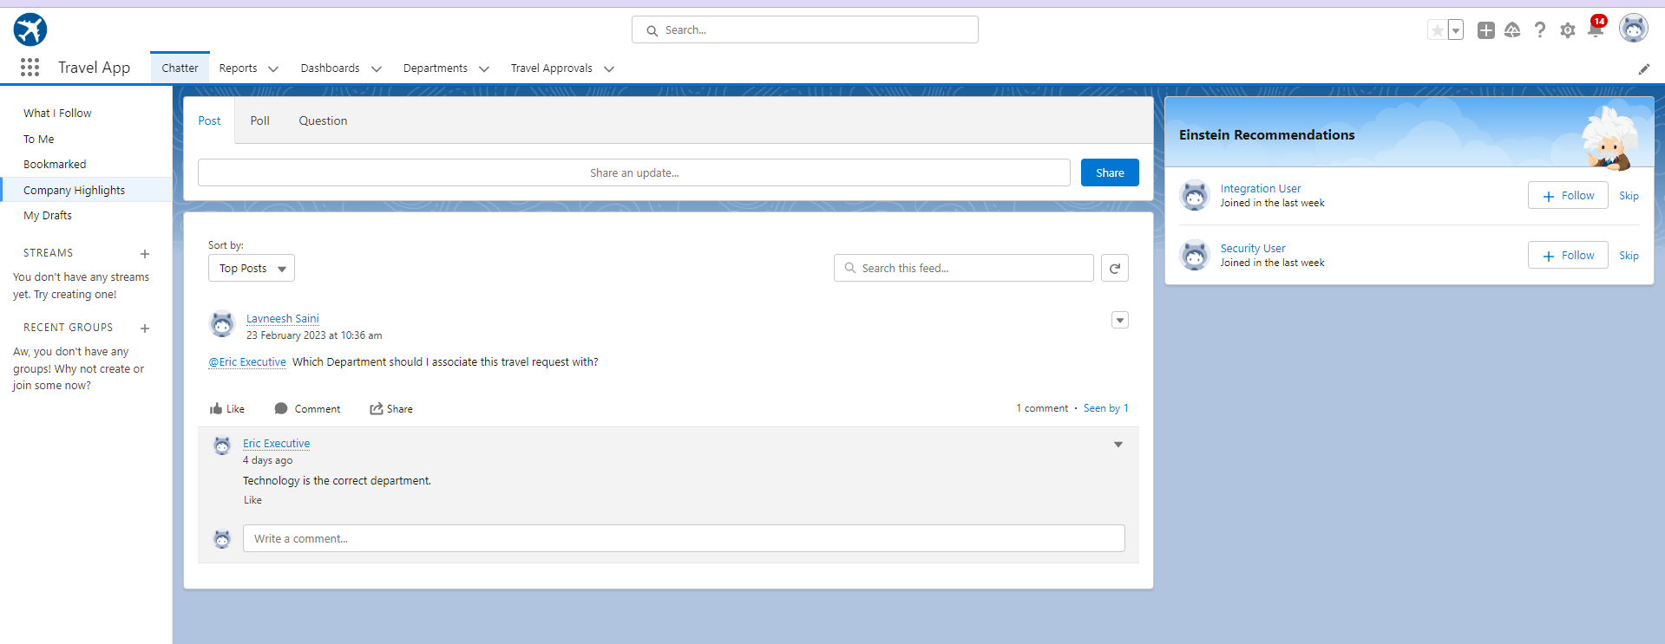

Slide 8
Steps Followed:
Creating Lightning Travel App Via App Manager
Creating Custom Objects Department, Travel Approval & Expense Items
Creating Custom Fields for the Custom Objects
Department Code, Location, Department Type for department objects
Purpose of trip, Trip Start/End Date, Destination State, etc for Travel Approval
Amount, Expense Type for Expense Item
Creating custom Tabs
Defining Relationships between objects.
Master Detail in Expense Item Related to Travel Approval
Lookup Related to Department Object

Slide 9
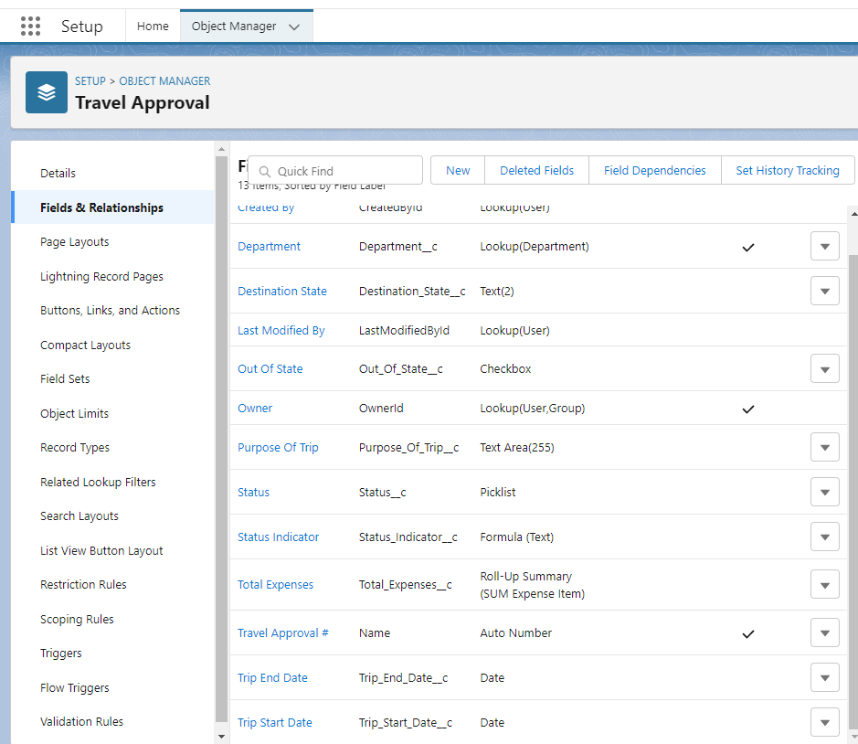
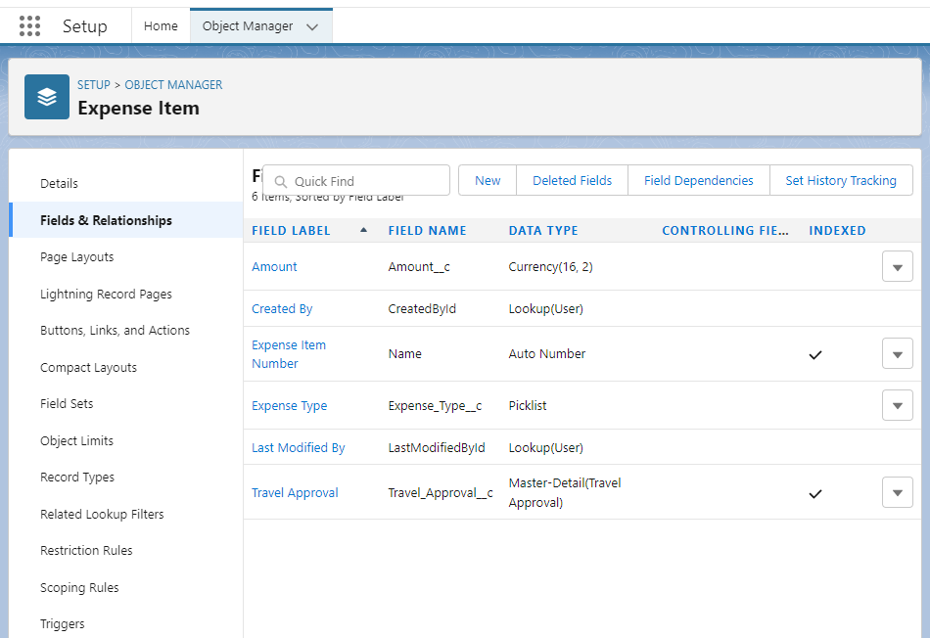

Slide 10
Steps Followed:
Creating Lightning Travel App Via App Manager
Creating Custom Objects Department, Travel Approval & Expense Items
Creating Custom Fields for the Custom Objects
Department Code, Location, Department Type for department objects
Purpose of trip, Trip Start/End Date, Destination State, etc for Travel Approval
Amount, Expense Type for Expense Item
Creating custom Tabs
Defining Relationships between objects.
Master Detail in Expense Item Related to Travel Approval
Lookup Related to Department Object

Slide 11
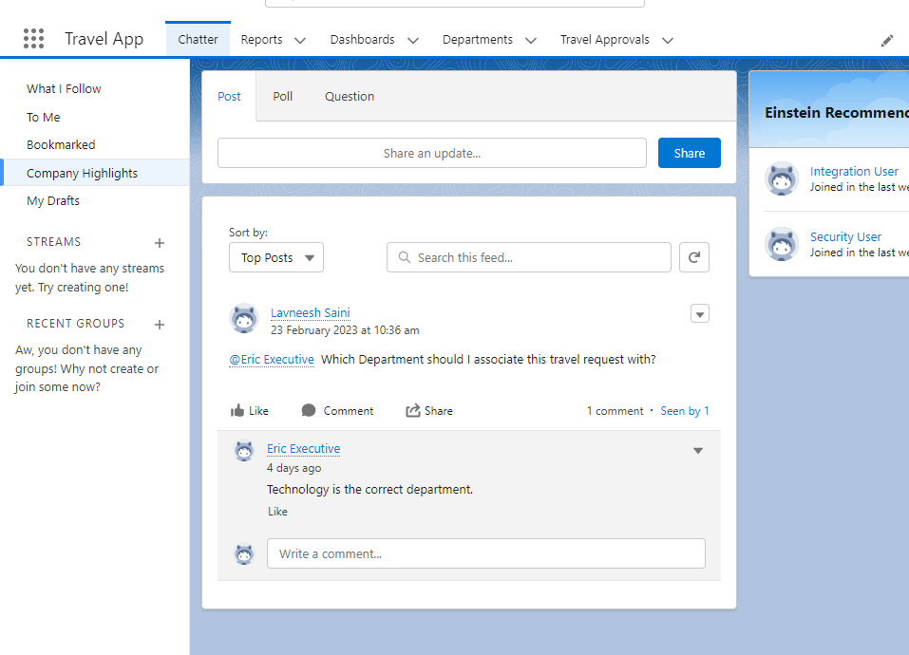

Slide 12
Steps Followed:
Importing Departments.csv File
Testing the App by creating Travel approval records and Expense Items
Creating User for CEO role, assigning CEO manager to System Administrator
Updating Approval page and search layout
Building Reports
Adding Validation Rules as per the requirements
Defining Approval Process for Travel Approval App
Building Dashboards

Slide 13
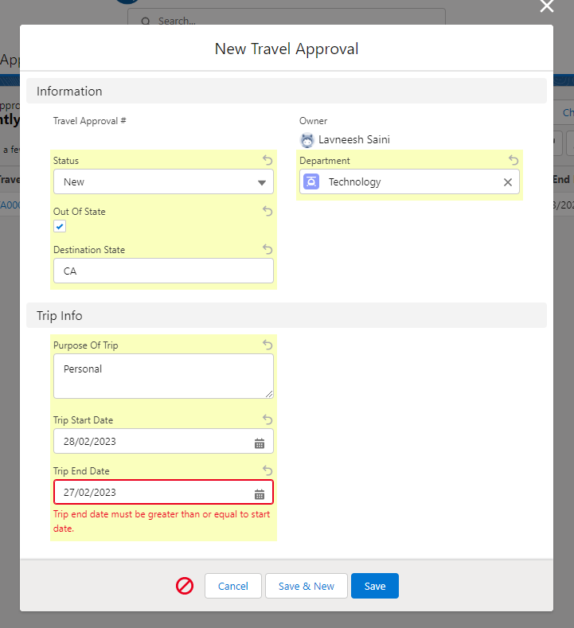
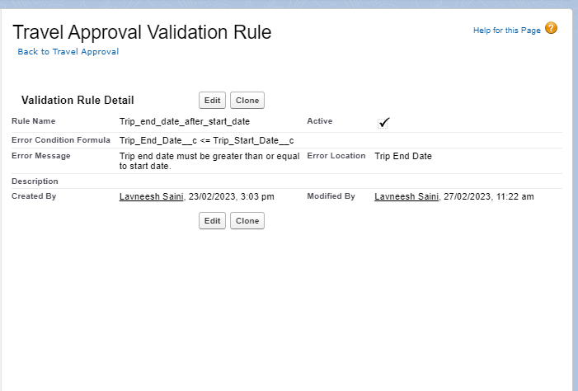

Slide 14
Steps Followed:
Importing Departments.csv File
Testing the App by creating Travel approval records and Expense Items
Creating User for CEO role, assigning CEO manager to System Administrator
Updating Approval page and search layout
Building Reports
Adding Validation Rules as per the requirements
Defining Approval Process for Travel Approval App
Building Dashboards

Slide 15
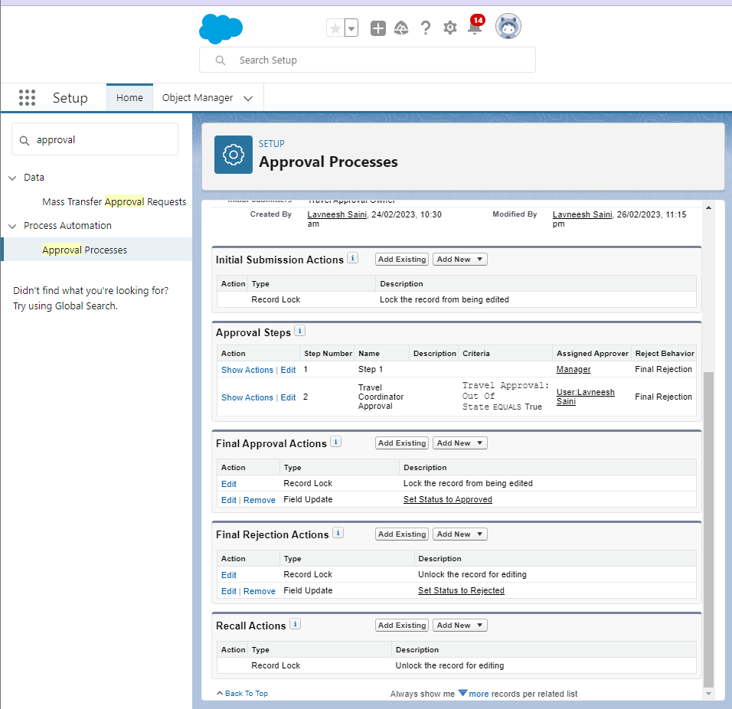

Slide 16
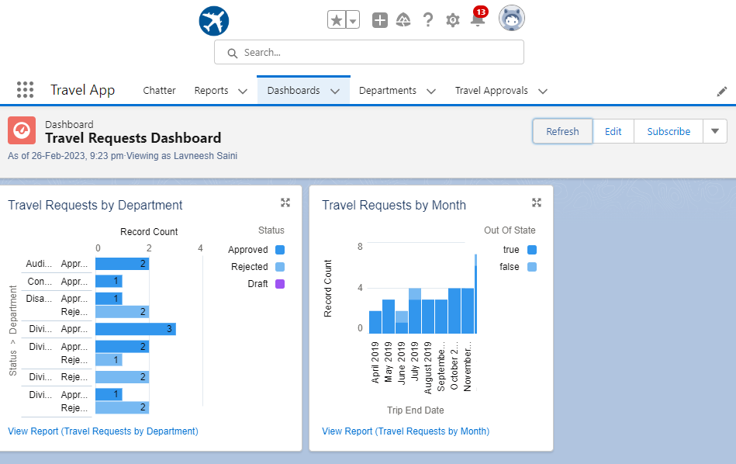

Slide 17
Module 3
Code Playground

